Slide 1
Defying Dark Silicon With Idempotent Processing
Karu Sankaralingam
Students: Marc de Kruijf, Venkatraman Govindaraju, Chen-han Ho, Tony Nowatzki, Matt Sinclair, Emily Blem, Garret Staus, Jesse Benson, Chris Frericks, Ryan Cofell, Jai Menon, Raghu Balasubramnian, Amit Kumar, Sung Jin Kim, Lorenzo de Carli, Michael Sartin-Tarm
Notes:
This presentation is on “Relax: An Architectural Framework for Software Recovery of Hardware Faults”
This is work done by myself, my colleague Shuou Nomura, and my advisor Karthikeyan Sankaralingam.

Slide 2
Microprocessor Performance
Multi-Core Promise
Problem
Performance (Log Scale)
Dark-Silicon
[ISCA-11]
Time

Slide 3
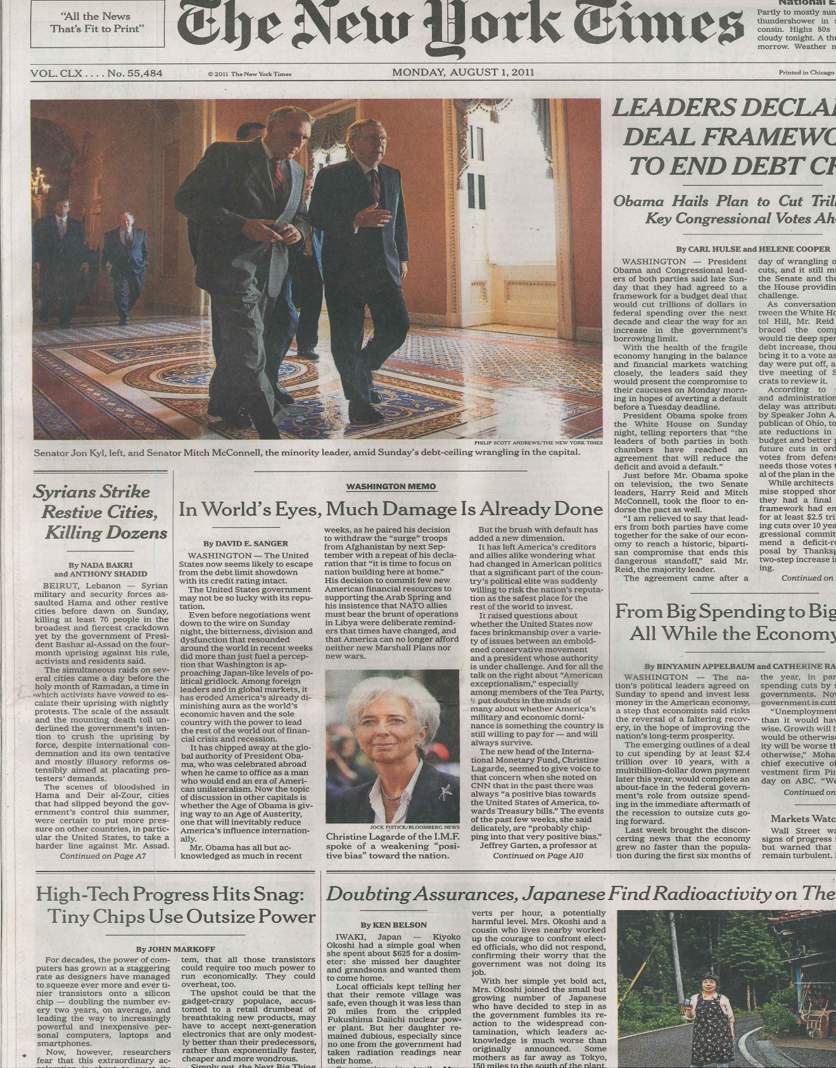

Slide 4
Why?
Architecture inefficient and inefficiencies amplified to
handle these device trends
Devices: End of voltage scaling Worse reliability
Details and model is in paper: Dark Silicon and the End of Multicore Scaling, ISCA 2011
Collaborator: Doug Burger – Microsoft Research
Notes:
Devices i) Voltage scaling ii) Worse reliability
Conventional microprocessors design
Application-agnostic design
Technology-agnostic design

Slide 5
Devices End of voltage scaling Worse reliability
Make devices work “correctly”
Improve efficiency of processor core Exploit abundant devices to enhance core
Architecture inefficient and inefficiencies amplified to
handle these device trends
Application properties
Notes:
Devices i) Voltage scaling ii) Worse reliability
Conventional microprocessors design
Application-agnostic design
Technology-agnostic design

Slide 6
Devices End of voltage scaling Worse reliability
Prototype Systems Microarchitecture Compilers
Analytical Models Formal Tools
Architecture inefficient and inefficiencies amplified to
handle these
Application properties
Notes:
Devices i) Voltage scaling ii) Worse reliability
Conventional microprocessors design
Application-agnostic design
Technology-agnostic design

Slide 7
Numerous instances to observe effect of a fault
Programs execute in phases 90/10 rule
Programs naturally decompose into restartable regions
Notes:
Conventional microprocessors design
Application-agnostic design
Technology-agnostic design

Slide 8
Numerous instances to observe effect of a fault
Notes:
Numerous instance to observe effect of a fault
Conventional microprocessors design
Application-agnostic design
Technology-agnostic design

Slide 9
Hardware Reliability
Wearout and permanent faults in hardware increasing
State-of-art
Fault detection heuristics
Do not work when #-cores is large
On 100-core chip, 99% coverage ⇒90% product quality
DMR
High area & energy overhead; complex implementation

Slide 10
Sampling-DMR [ ISCA-11]
Fault
occurs
Original Execution
errors
Time
Redundant
Execution
detection
100% detection, low energy overhead, simple impl.
OpenRISC on FPGA with full applications
Mathematical proof for missed errors and Markov model for detection latency
All low overhead techniques have undetected errors
Almost ^

Slide 11
Programs execute in phases 90/10 rule
Notes:
Conventional microprocessors design
Application-agnostic design
Technology-agnostic design

Slide 12
DySER Architecture
How to improve energy efficiency of computation?
State-of-art:
Domain-specific: CCA, Mathstar, Tensilica
Hard-to-program: SSE, GPU
Overly complex or intrusive: TRIPS, Phoenix

Slide 13
DySER Architecture [ HPCA-11]
Dynamically specialize hardware to computation
Compiler finds path-trees and configures datapath
Use main processor for infrequent code and ld-slice
Fetch Decode Execute Mem Wr.Back
Decode
Exec
Units
I$
Register
File
D$
DySER

Slide 14
DySER Architecture
1.2X to 10X speedup to a 2-issue OOO
Over 50% energy efficiency
Throughput kernels (Intel Labs): 7X to 12X better than hand-coded SSE
Really buildable? (50-person months)
LLVM compiler for ARM, x86, SPARC done
OpenSPARC integration and FPGA bringup complete; performance evaluation on-going

Slide 15
Programs naturally decompose into restartable regions
Notes:
Conventional microprocessors design
Application-agnostic design
Technology-agnostic design

Slide 16
An Example: insert into list
bool overflow = […]
t2=mem[t0+4]
t3=mem[t0+8]
t3 = t2== t3 if (overflow)
if t3 > 0
1 typedef struct {
2 int *buf; // buffer
3 int size; // num elements
4 int cap; // capacity
5 } list_t;
6
7 extern list_t *overflow_list;
8
9 int list_push(list_t *list,
10 int elem)
11 {
12 // check for overflow
13 int overflow =
14 (list->size == list->cap);
15
16 // if overflow use other list
17 if (overflow)
18 list = overflow_list;
19
20 // insert at end of list
21 list->buf[list->size] = elem;
22 list->size++;
23
24 return overflow;
25 }
list = other_list t0 = {other_list}
list->buf[…] = elem
t2 = mem[t0+0] t3 = mem[t0+4] mem[t2+t3] = t1
list->size++ t3=t3+1
mem[t0+4]=t3

Slide 17
Remove artificial antidependences
bool overflow = […]
t2=mem[t0+4]
t3=mem[t0+8]
t3 = t2== t3 if (overflow)
If t3 > 0
list = other_list t4 = {other_list}
t4 = t0
list->buf[…] = elem
t2 = mem[t4+0] t3 = mem[t4+4] mem[t2+t3] = t1
list->size++ t3=t3+1
mem[t4+4]=t3

Slide 18
Idempotence Definition and Concept
A
B
C
D
A
A
B
C
D
A
B
B
B
C
D
D

Slide 19
Free recovery
Efficient software-only recovery
Improve and simplify conventional in-order processors
GPUs with free speculation
Transient noise, timing-speculation, branch-prediction come for free
OOO processing without recovery structures
ROB, rename checkpoints, LSQ
Easy integration of speculative hardware modules
Analog unit, speculative adders, etc.

Slide 20
Idempotent Processing
Do such regions exist, how large are they?
Can a compiler find them?
How exactly to exploit in architecture?
How useful is it?

Slide 21
Do such regions exist?
90
Naïve
Perfect
80
70
60
50
40
Avg. # of insts
30
20
10
0

Slide 22
Idempotent Processing
Do such regions exist, how large are they?
Yes, usefully large
Can a compiler find them?
How exactly to exploit in architecture?
How useful is it?

Slide 23
Conventional Compiler
bool overflow = […]
t2=mem[t0+4]
t3=mem[t0+8]
t3 = t2== t3 if (overflow)
If t3 > 0
1 typedef struct {
2 int *buf; // buffer
3 int size; // num elements
4 int cap; // capacity
5 } list_t;
6
7 extern list_t *overflow_list;
8
9 int list_push(list_t *list,
10 int elem)
11 {
12 // check for overflow
13 int overflow =
14 (list->size == list->cap);
15
16 // if overflow use other list
17 if (overflow)
18 list = overflow_list;
19
20 // insert at end of list
21 list->buf[list->size] = elem;
22 list->size++;
23
24 return overflow;
25 }
list = other_list t0 = {other_list}
list->buf[…] = elem
t2 = mem[t0+0] t3 = mem[t0+4] mem[t2+t3] = t1
list->size++ t3=t3+1
mem[t0+4]=t3

Slide 24
Idempotent Compiler
Recall: sequence of instructions is idempotent
Does not contain any anti-dependences (WAR)
Unless preceded by a flow-dependence (RAW)
Determine semantic anti-dependence
typically heap and global memory
Remove artificial anti-dependence
typically registers and stack variables

Slide 25
Compiler Design
Convert to SSA
Some memory redundancy elimination
Convert to Program Dependence Graph (PDG)
Determining regions is equivalent to cuts in graph
Need to maximize region size

Slide 26
Idempotent Regions as PDG Cuts
S1
S2
S3
S4
S5
bool overflow = […]
t2=mem[t0+4]
t3=mem[t0+8]
t3 = t2== t3 if (overflow)
If t3 > 0
S₁
S₂
t₂=mem[t₀+ 4]
t₃=mem[t₀+ 8]
S₃
S₅
t₃=t₂== t₃
t₅=φ(t₀, other-list)
S₄
list = other_list t5 = φ {t0, other_list}
if t₃=> 0
S₆
S₇
t₆=mem[t₅+ 0]
S6
S7
S8
S9
S10
list->buf[…] = elem
t6 = mem[t5+0] t7 = mem[t5+4] mem[t6+t7] = t1
list->size++ t8=t7+1
mem[t5+4]=t8
t₇=mem[t₅+ 4]
S₈
S₉
mem[t₆+ t₇] = t₁
t₈=t₇+1
S₁₀
mem[t₅+ 4] = t₈

Slide 27
Static Analysis for PDG Cuts (1)
Graph decomposition problem:
Set of sub-graphs, with a header node from which all nodes are reachable
No anti-dependence edges in any sub-graph
We need smallest set of subgraphs
h1
Control-Flow graph
Anti-dependences
A
A
h2
A
B
C
B
C
B
C
D
D
D

Slide 28
Static Analysis for PDG Cuts (2)
Optimal decomposition Equivalent to vertex multicut which is equivalent to hitting-sets problem
Has well known approximation heuristics

Slide 29
Compiler Implementation
Implemented as a pass in LLVM
Some backend-specific tuning
x86, x86-64, ARM
Working compiler for SPEC, Parsec, Parboil

Slide 30
Compiler Constructed Regions
80
Conventional
70
Idem
-
60
Compiler
50
Perfect
40
30
Avg. # of insts
20
10
0

Slide 31
Compilation Overheads
14
Inst Count
Exec Time
12
10
8
Percentage Overhead
6
4
2
0

Slide 32
Idempotent Processing
Do such regions exist, how large are they?
Yes, usefully large
Can a compiler find them?
Yes
How exactly to exploit in architecture?
Transient fault recovery
In-order processing
How useful is it?

Slide 33
Transient Fault Recovery
Software only recovery for transient faults
Instruction-TMR is state-of-art [Chang et al.]
DMR for detection and idempotence for recovery is more efficient
Apply to off-the-shelf microprocessor

Slide 34
Results for ARMv7
45
Instruction
-
TMR
Idempotence
40
35
30
25
Exec. Time Overhead (%)
20
15
10
5
0

Slide 35
Idempotent Processing
Do such regions exist, how large are they?
Yes, usefully large
Can a compiler find them?
Yes
How exactly to exploit in architecture?
Transient fault recovery
In-order processing
Speculation support for GPUs
How useful is it?

Slide 36
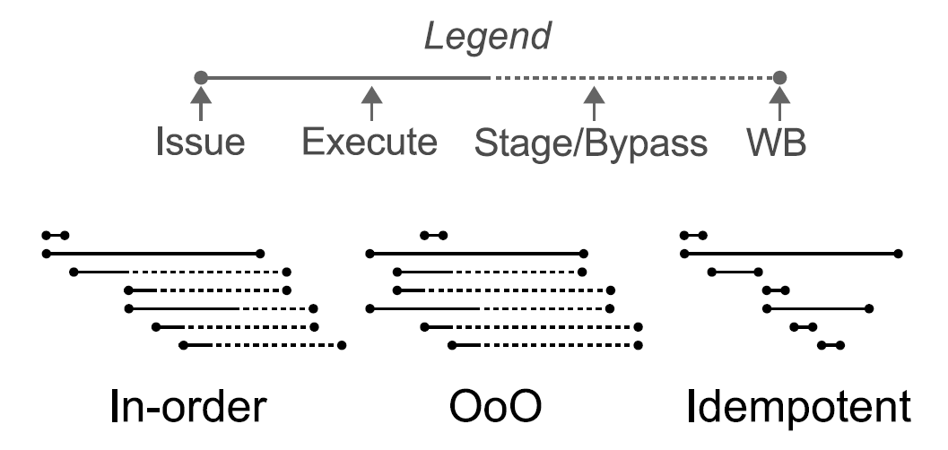
More Efficient Processors: OOO Retire
Lots of complexity for in-order retirement

Slide 37
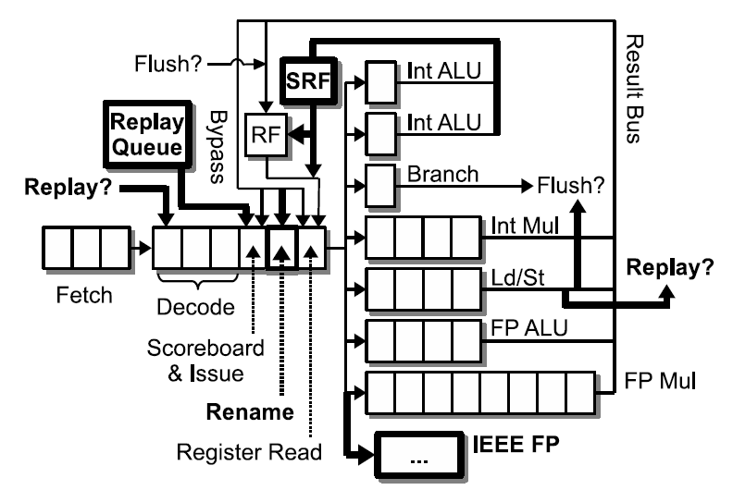
Modern In-Order Processor
Even in-order processor is messy: SRF for bypass values, additional rename stage, pipeline flush for exceptions, replay queue, …

Slide 38
Idempotent Processor Architecture
Simple design, yet high performance and energy efficient

Slide 39
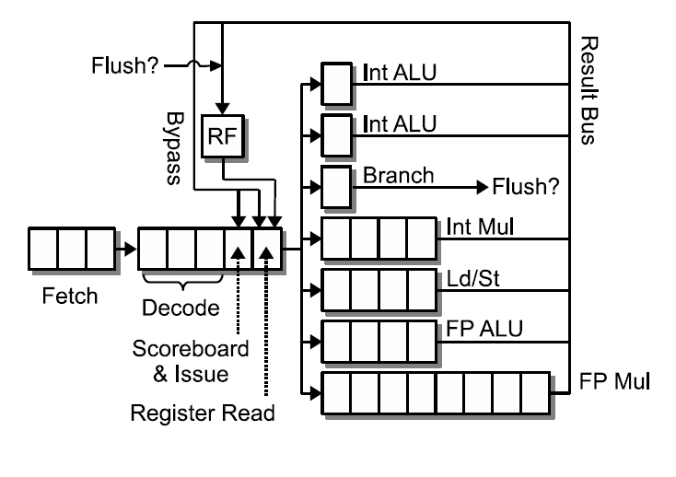
Idempotent Processor (Lean)
Result bus contention
Constrained issue between regions

Slide 40
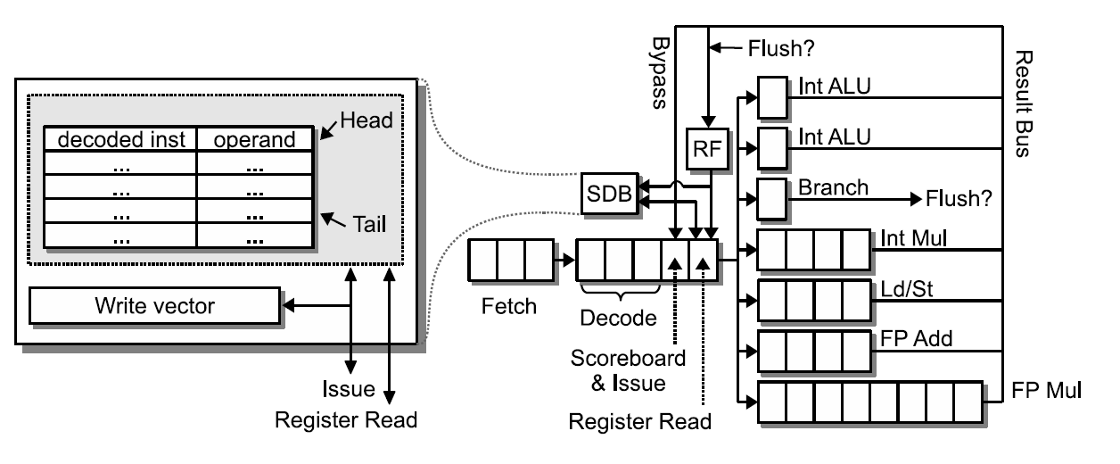
Idempotent Processor (Fast)
Issue miss-dependent inst. to SDB Unblock pipeline issue and retire OOO

Slide 41
Results
GEM5 simulation framework
ARMv7 ISA
Both in-order and OOO configurations
5-billion instructions forwarded and 100-million simulated (measured in function call equivalents)
Conventional and Idempotent binaries

Slide 42
Performance Evaluation
Baseline: in-order + conv. binary
1.5
Lean
Fast
OoO
1.25
Speedup
1
0.75
Out-performs complex In-order
Within 24% of OOO

Slide 43
Energy Reduction
2
vs. In
-
Order
vs. OoO
1.75
1.5
1.25
1

Slide 44
How did we get here?
Relax [ ISCA-10 ]
Programmer identified recovery/discard regions
Apply Relax in HPC
LLNL cluster and applications
Timing-speculation model [ DSN-10 ]
Logic emulation of delay behavior [ ITC-10 ]
Realized programmer is identifying idempotent regions

Slide 45
Devices End of voltage scaling Worse reliability
Reliable and Energy Efficient Systems
Architecture inefficient and inefficiencies amplified to
handle these device trends
Application properties
Notes:
Devices i) Voltage scaling ii) Worse reliability
Conventional microprocessors design
Application-agnostic design
Technology-agnostic design

Slide 46
Numerous instances to observe effect of a fault
Programs naturally decompose into restartable regions
Programs execute in phases 90/10 rule

Slide 47
Perfect S-DMR?
Numerous instances to observe effect of a fault
System guarantees
Transient Faults
Programs naturally decompose into restartable regions
iGPU OOO hybrid
OpenRISC Prototype
Programs execute in phases 90/10 rule
Dynamic SSE/GPU iDySER
Notes:
Conventional microprocessors design
Application-agnostic design
Technology-agnostic design

Slide 48
Numerous instances to observe effect of a fault
Reliability
Programs naturally decompose into restartable regions
Post CMOS
Idempotent recovery
Programs execute in phases 90/10 rule
Specialization

Slide 49
Questions
Notes:
Conventional microprocessors design
Application-agnostic design
Technology-agnostic design

Slide 50
Idempotence applied to GPUs
BlackScholes | 3487 | backprop | 198
LIB | 18 | leukocyte | 71
LPS | 11 | lud | 277
MUM | 10 | nw | 116
NN | 415 | particlefilter | 472
NQU | 45 | srad | 49
RAY | 381 | heartwall | 130
WP | 68
STO | 2517
Software only transient voltage noise recovery
Removes margin for voltage noise (20% energy savings)
Timing-speculation without pipeline flush
Depends on real error-rates

Slide 51
Summary
Idea of idempotence is interesting and useful
OOO/Idempotence hybrids
Prototype OpenRISC-based processor
Multi-processor issues

Slide 52
Conclusions
Dark silicon gap requires efficient architecture
Exploit application properties
Idempotence provides “free” recovery

Slide 53
Questions
Notes:
Conventional microprocessors design
Application-agnostic design
Technology-agnostic design

Slide 54
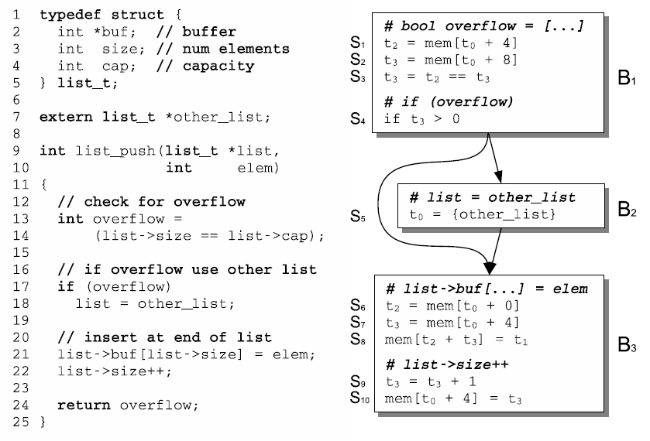
An Example: insert into list

Slide 55
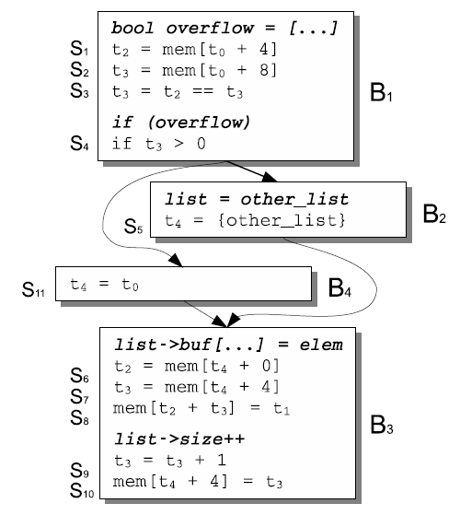
Remove artificial antidependences

Slide 56
bool overflow = […]
t2=mem[t0+4]
t3=mem[t0+8]
t3 = t2== t3 if (overflow)
If t3 > 0
list = other_list t4 = {other_list}
t4 = t0
list->buf[…] = elem
t2 = mem[t4+0] t3 = mem[t4+4] mem[t2+t3] = t1
list->size++ t3=t3+1
mem[t4+4]=t3

Slide 57
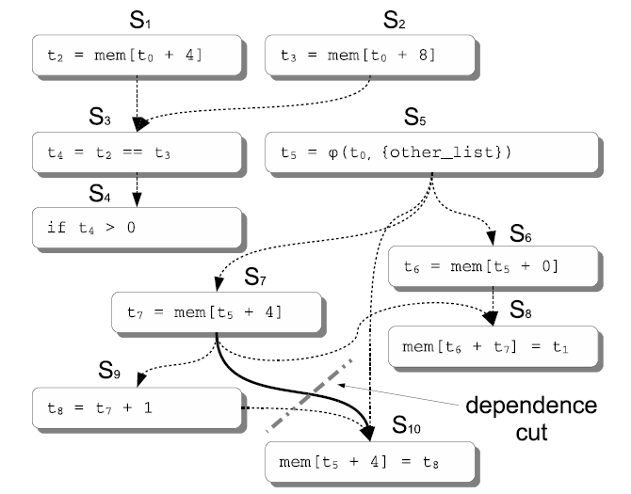
Idempotent Regions as PDG Cuts

Slide 59
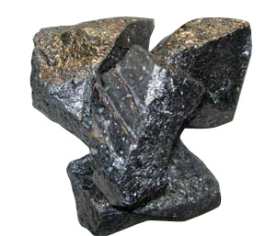
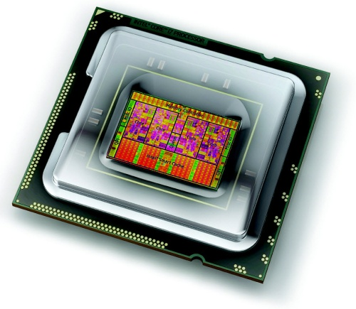
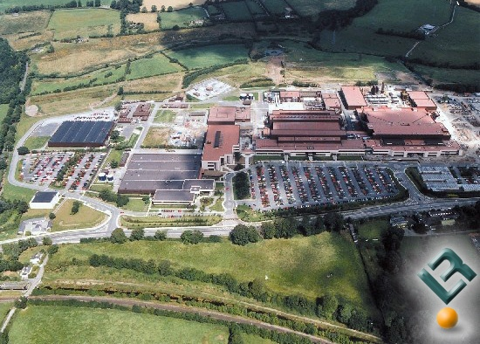
The World of Microprocessors
Silicon

Slide 60
Future Trends
Voltage scaling stopping
Reliability
Process variations, EM, TDDB, NBTI, HCI…Your favorite acronym

Slide 61
A Perfect Storm
Transistor energy efficiency not keeping up with integration
Transistor reliability decreasing
Add margins….
But makes energy efficiency worse, erodes scaling benefits
Emergence of “Dark Silicon”: parts of chip must remain turned off

Slide 63
Quantifying Dark Silicon
What can conventional processors provide under:
Fixed area budget
Fixed power budget
Two sets of CMOS scaling projections
“Real” Parallel benchmarks: PARSEC
For next 5 technology generations, we find the best performing multicore from a comprehensive design space search for each of the PARSEC benchmarks

Slide 64
Multicore Processors
18x
3.4x
in 10 years

Slide 65
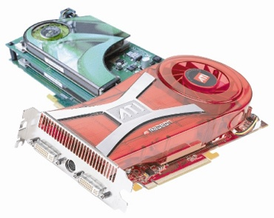
But, what if?
DVFS Turboboost
Assymetric Multicore
Core-Fusion Composable Cores

Slide 66
Best-Case Multicore Era Projections
18x
3.7x
The best designs speed up 14% per year
rather than the recent trend of 34% per year

Slide 67
Why Diminishing Returns?
Transistor area is still scaling
Voltage and capacitance scaling have slowed
Must address inefficiencies in processors

Slide 68
The World of Microprocessors
Silicon

Slide 69
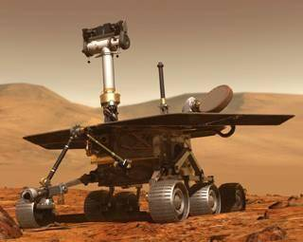
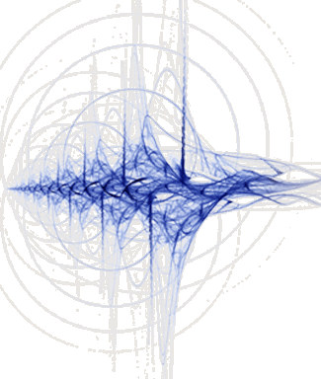
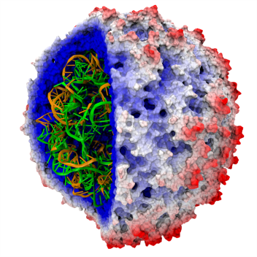
The World of Microprocessors
100110101101
001011001010
111001010111
000100001101
Search
Computer Vision
Data Mining
Media Processing
Scientific Computing
…
Applications Trend
Data-intensive, error-tolerant applications

Slide 70
A Vertical Approach
Exposing Application Error-Tolerance to Hardware
Relaxed hardware reliability
Principle of Idempotence
Idempotent Processors
Sampling-DMR: a formally proven detection mechanism
Exposing Application Execution to Hardware
DySER Architecture

Slide 71
Relax: Cross-layer Reliability
Problem
Technology is driving simple hardware to conserve energy
Fault recovery requires complex hardware
Software Recovery
Enables simple hardware
High energy efficiency
Relax: An Architectural Framework for Software Recovery
ISA: a well-defined interface for software recovery
Software: support to use the ISA
Hardware: support to implement the ISA
Many results in our ISCA 2010 paper.
Notes:
Computer architects are facing a dilemma.
On the one hand, technology scaling and energy efficiency concerns are driving simple hardware.
But on the other hand, transistors and circuits are becoming increasingly prone to faults, and hardware mechanisms for fault recovery lead to complex hardware.
These are clearly two conflicting concerns.
[click]
So what we propose is to use software recovery instead of hardware recovery.
Software recovery enables simple hardware and can achieve high energy efficiencies.
[click]
Our framework called, Relax, leverages hardware for fault detection, and altogether consists of three core components:
The first component is a simple ISA extension that allows fine-grained software recovery of faults detected in hardware.
The second component is language and compiler-level support in software that enables applications to use the ISA.
Finally, the third component is hardware that implements the ISA.
[click]
But before we delve into the details, let’s first let’s take a step back and look at the trends in computer architecture that lead us to propose software recovery.

Slide 72
Vdd
Search
Computer Vision
Data Mining
Media Processing
Scientific Computing
…
In
Out
Architecture Trend
Energy efficiency
Hardware simplification
CMOS Trend
Device variability,
wear-out, soft errors
Applications Trend
Data-intensive, error-tolerant applications
Notes:
Finally, we have the low-level CMOS trend, which is that hardware is getting increasingly fragile as devices continue to decrease in size.
[click]
CMOS devices are subject to various sources of variability, wear-out, and soft errors.

Slide 73
Vdd
Search
Computer Vision
Data Mining
Media Processing
Scientific Computing
…
In
Out
Recovery Support
Is Needed
?
?
Architecture Trend
Energy efficiency
Hardware simplification
CMOS Trend
Device variability,
wear-out, soft errors
Applications Trend
Data-intensive, error-tolerant applications
Complex Hardware
Speculative state
Efficient
Error tolerance
Natural recovery points
Simple Hardware
No speculative state
Hardware Recovery
Software Recovery
Inefficient
No flexibility
Checkpoints conservative
Notes:
[click][click]
The outcome of this CMOS trend is that fault recovery support is becoming a necessity. We have one option
[click]
Which is to use hardware recovery
[click]
However, this involves the hardware maintaining speculative rollback state in the form of a checkpoint or log in case a fault occurs and state must be recovered.
[click]
This does not mesh well with the trend towards simpler hardware
[click]
Additionally, hardware recovery is inflexible for emerging applications.
Applications cannot employ recovery behaviors other than simple re-execution.
Hardware checkpoints often save more state than is strictly necessary, and even if a checkpoint is appropriate, hardware has only limited information and will not take checkpoints at the instances that are most efficient for the application.
[click]
Hence, hardware recovery is not a good fit for emerging applications either.
[click]
So we consider a different alternative: software recovery
[click]
Software recovery enables simple hardware
[click]
Which fits well with many-core platforms.
[click]
Software recovery also allows us to implement flexible recovery policies to allow applications to exploit their tolerance to errors, and we can choose natural recovery points and only save the state that we really need to.
[click]
Which works nicely with the emerging class of applications
[click]
The question remains though, how do we do this: how do we achieve both simple hardware and efficiency with software recovery?
[click]

Slide 74
Relax
Software Recovery
ISA
Hardware Detection
Notes:
[click]
Software appears to be a good fit for recovery
[click]
However, for detection, software typically has relatively high overheads and low fault coverage,
so we believe hardware is still the better option for fault detection.
[click]
To enable the inter-operation of software recovery with hardware detection, we propose a simple ISA interface between the two.
The final picture is the basis of our proposed framework, Relax.
[click]

Slide 75
ISA
rlx RECOVER
...
RECOVER:
...
Software defines recovery handler
Hardware detects and jumps to handler on fault
and is allowed to commit corrupted state*
*Details in paper
Notes:
The design of the ISA should meet several goals.
[click]
It must allow the hardware to remain simple
[click]
The software should be able to define the recovery behavior
[click]
In a way that applications can exploit error tolerance
[click]
Or otherwise recover in a flexible way,
[click]
Through a simple mechanism
[click]
That is efficient
What we implement is the following:
[click]
We define a special type of instruction, called a relax instruction, that allows the software to register a recovery handler with the hardware.
The instruction takes as argument the address of the recovery code
[click]
The hardware detects hardware faults and jumps to the recovery code shortly after a fault occurs. During the time between when the fault occurs and when the hardware detects the fault, the hardware is allowed to commit potentially corrupted state to registers and memory, subject to certain constraints that we detail in the paper.
[click]
This simple ISA extension allows applications to utilize their error tolerance,
[click]
And employ other flexible recovery behaviors
[click]
That they define themselves.
[click]
In a way that is simple
[click]
Allows simple hardware
[click]
And is energy efficient

Slide 76
Software
-- WARNING --
Source Code Ahead
SAD (Sum of Absolute Differences) Example
(adapted from a H.264 video encoder)
int sad(int *left, int *right, int len)
int sum = 0;
for (int i = 0; i < len; ++i) {
sum += abs(left[i] - right[i]);
}
return sum;
}
Notes:
Okay, now just to warn you, I am about to show you some code.
Just to put your mind at ease, you don’t need to read and understand every line of code.
In fact, if you can follow along with the animations, you shouldn’t need to understand any of it.
Okay. With that out of the way, here we go….

Slide 77
Software
SAD (Sum of Absolute Differences) Example
(adapted from a H.264 video encoder)
ENTRY:
mv 0 -> $sum
ble $len, 0, EXIT
LOOP_PREHEADER:
mv 0 -> $i
LOOP:
ld [$left + $i * 4] -> $tmp1
ld [$right + $i * 4] -> $tmp2
abs $tmp1, $tmp2 -> $tmp3
add $sum, $tmp3 -> $sum
add $i, 1 -> $i
blt $i, $len, LOOP
EXIT:
rlx 0 # Relax off
ret $sum
int sad(int *left, int *right, int len)
int sum = 0;
for (int i = 0; i < len; ++i) {
sum += abs(left[i] - right[i]);
}
return sum;
}
No writes to memory
No side-effects
Recoverable by re-execution
rlx RECOVER # Relax on
Simple + Intuitive + FLEXIBLE
int sad(int *left, int *right, int len)
int sum = 0;
for (int i = 0; i < len; ++i) {
sum += abs(left[i] - right[i]);
return sum;
}
raw
relax {
} recover { retry; }
} recover { return INT_MAX; }
encoded
return 0x7FFFFFF # “discard”
RECOVER:
jmp ENTRY # “retry”
Notes:
[click]
This C function computes the sum of absolute differences over two lists of integers.
[click]
An H.264 encoder uses a function similar to this to compute the color difference between two blocks of pixels, which are stored in memory as arrays of integers, across frames.
[click]
A block that is very similar to a previously occurring block can be encoded as only the difference between the two blocks, which conserves space.
First, observe that this function does not write to memory, it only reads from memory.
As a result, we say this function is side-effect free because it does not alter any program state outside of itself; it has some input arguments, and it returns an output; that is all.
Because it is side-effect free, we could trivially recover this function simply by re-executing it.
With Relax, we might express this as follows.
[click]
The relax keyword, highlighted in sort of a pinkish red, starts a block of code where hardware faults are handled by the recover block, which also highlighted. In this case, the recover block simply causes re-execution of the relax block as just described.
[click]
Something that it is intended to look a bit like assembly code is shown on the right, with the relax extensions again highlighted in pink.
We see the relax instruction
[click]
Which points to the recovery code.
[click]
Which simply jumps back to the function entry point.
[click]
And we have an instruction here that terminates the relax block, but could also start a new relax block.
[click]
Now say for example that we don’t want to re-execute in case of a fault, and we want to discard the computation instead.
We might do the following
[click][click][click][click]
So now, if there is a fault, the function will simply return the maximum possible absolute difference value.
For the h.264 encoder algorithm, what this means is that the two macroblocks being compared are extremely dissimilar and should not be encoded together. The encoder will effectively ignore the result of this computation.
The assembly code will look like this:
[click][click][click]
[click]
That is the basic idea.
There are some additional subtleties to do with how a compiler preserves input state from registers and the program stack.
If you are interested, please see the paper for more details.

Slide 78
Hardware
Microarchitecture
Fine-grained hardware detection (e.g. Argus)
Recovery PC register + control logic
Simple Microarchitecture
Notes:
The microarchitecture support for Relax is minimal
[click]
We need essentially only two things.
First, we need fine-grained hardware detection, for which Argus, proposed in MICRO a few years back, provides a good starting point
And second, we need a little bit of hardware for the relax instruction itself in the form of an extra register to hold the address of the recovery PC and a little bit of extra control logic.

Slide 79
Evaluation
Is it useful?
How useful is it?
Notes:
What do we want to know about Relax?
[click]
We want to know: is it useful? And if so, how useful is it?
[click]
Is it useful?
[click]
To answer this question, we implemented a compiler with the language support we described.
[click]
We modified 7 applications to use Relax. All applications were initially drawn from the PARSEC suite, although two were replaced with similar versions of the applications from different benchmark suites for technical reasons.
[click]
For each application, we chose the single, most dominant function to use Relax, and
we implemented both retry-based recovery as well as discard-based recovery over that function.
For discard-based recovery, although the result of the function’s computation was effectively thrown away each application continued to function correctly with this behavior.
[click]
The percentage execution time of the functions we chose for each application are shown in the table on the right.
For three applications, the function contributed over 80% of application execution time; for two others, the contribution was roughly 50%, and for the remaining two, it was about 20%.

Slide 80
Is it Useful?
Language support using LLVM
One relax region per application (most dominant function)
Retry and discard behavior
7 Applications
Application Name | Percent Execution Time Contribution of Function
BarnesHut (Lonestar) | >99.9%
bodytrack (PARSEC) | 21.9%
canneal (PARSEC) | 89.4%
ferret (PARSEC) | 15.7%
kmeans (MineBench) | 83.3%
raytrace (PARSEC) | 49.4%
x264 (PARSEC) | 49.2%
It works!
Notes:
What do we want to know about Relax?
[click]
We want to know: is it useful? And if so, how useful is it?
[click]
Is it useful?
[click]
To answer this question, we implemented a compiler with the language support we described.
[click]
We modified 7 applications to use Relax. All applications were initially drawn from the PARSEC suite, although two were replaced with similar versions of the applications from different benchmark suites for technical reasons.
[click]
For each application, we chose the single, most dominant function to use Relax, and
we implemented both retry-based recovery as well as discard-based recovery over that function.
For discard-based recovery, although the result of the function’s computation was effectively thrown away each application continued to function correctly with this behavior.
[click]
The percentage execution time of the functions we chose for each application are shown in the table on the right.
For three applications, the function contributed over 80% of application execution time; for two others, the contribution was roughly 50%, and for the remaining two, it was about 20%.

Slide 81
How Useful Is It?
Software recovery for timing speculation
Notes:
[click]
How useful is it?
[click]
To answer this question, we applied software recovery with Relax to a technique known as timing speculation.
[click]
Under timing speculation, some timing faults are allowed to occur in the hardware.
As a result, the hardware operates more efficiently with reduced timing margins, and the infrequently occurring timing faults are automatically recovered by the system.
If the efficiency gains exceed the cost of recovery, then there is a net benefit, and timing speculation improves overall efficiency.

Slide 82
Results – Execution Time
Execution time overhead is less than 10% and 1% typical
Discard performance is comparable to retry
*error rates range from 10⁻³ to 10⁻⁶ errors/cycle
Notes:
Here we show the execution time results for each of the seven applications.
Each application has a different error rate, but the rates are all in the range of 1/thousand to 1/million errors per cycle.
On the x-axis are the applications, and the y-axis shows execution time with Relax and with faults normalized to executing without Relax with no faults.
Let’s first look at the results for retry behavior, shown by the orange bars, since those results are straightforward to explain.
For retry behavior, we expect the normalized execution time to always be greater than 1, since intuitively Relax and the faults themselves introduce recovery overheads.
Indeed, we see this is always true.
The execution time is always worse, however – and this is our first major result [click] – the overhead is never greater than 10% of the original execution time, and an overhead of only 1% is typical.
The discard results, shown by the blue bars, require a little more explanation.
First, you might be thinking, with discard behavior faults reduce the quality of the application’s output, so how can you make a fair comparison?
Yes you are right, but we implemented a solution to this problem.
We compensate for the quality reduction by simply doing more work such that the quality is the same executing with and without faults and it’s only execution time that changes.
The paper has the details on how we achieve this.
For discard behavior, we also expect the normalized execution time to always be greater than 1 since we expect that additional work is required to achieve the same level of output quality as if there were no faults.
The blue bars show that in most cases this is true and the results for discard closely match the results for retry,
However, in two cases in particular the results for discard are substantially better.
[click]
What is happening here is subtle but I will do my best to explain it.
Recall that these bars are showing the execution time required to achieve the same level of output quality executing with faults, as compared to executing without faults.
So what we see, then, is that for these two applications, using discard behavior has effectively little or no impact on the output quality, because we can achieve the same output quality discarding a large percentage of our work.
For x264, this effect is extreme – it’s as if the function has no impact.
Bodytrack, on the other hand, is a little different.
The program essentially has a boolean output -- either it is tracking the body position or it isn’t.
We were able to discard a lot of computation before the boolean output switched from a yes to a no.
Overall, we find that in most cases discard performance is at least comparable to retry behavior.

Slide 83
Results – Energy-delay
Relax achieves energy improvements for timing speculation
*error rates range from 10⁻³ to 10⁻⁶ errors/cycle
Notes:
In this graph, we apply our hardware efficiency model to the execution time data shown on the previous slide to estimate overall energy efficiency under timing speculation.
In all cases the energy efficiency using Relax improves over perfect hardware that does not allow any errors, and we see that a 20% energy-delay reduction is common.
[click]
The main result here is that Relax allows substantial energy efficiency gains under timing speculation.

Slide 84
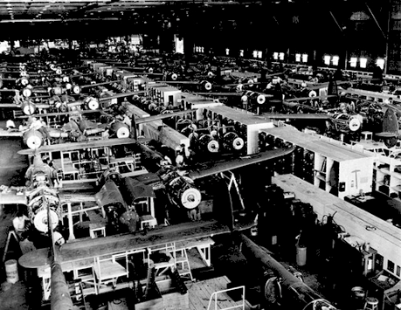
Can we automate this?

Slide 85
A Vertical Approach
Exposing Application Error-Tolerance to Hardware
Relaxed hardware reliability
Principle of Idempotence
Idempotent Processors
Sampling-DMR: a formally proven detection mechanism
Exposing Application Execution to Hardware
DySER Architecture

Slide 86
Idempotent Processing
A program region can be recovered by re-execution if inputs are not corrupted
We observe and show that programs can be deconstructed into a continuous set of such regions

Slide 87
Idempotent Processing
Idempotent regions are basic execution block
Faults can be Exceptions, Branch mis-predictions, soft-errors, transient noise etc.

Slide 88
Idempotent Processor Architecture

Slide 89
Idempotent Processor Architecture
Lots of complexity for in-order retirement

Slide 90
Idempotent Processor Architecture
Simple design, yet high performance and energy efficient

Slide 91
Modern In-Order Processor
Even in-order processor is messy: SRF for bypass values, additional rename stage, pipeline flush for exceptions, replay queue, …

Slide 92
Idempotent Processor (Lean)

Slide 93
Idempotent Processor (Fast)

Slide 94
What do we lose?
Can a compiler do this?
Yes: Problem generalizes to a graph vertex-cut problem
Compilation overheads
Applications may limit size of regions
Potentially large recovery cost

Slide 95
Evaluation Methodology
Implemented compiler pass in LLVM
Both for x86 and ARM
GEM5 and native execution results

Slide 96
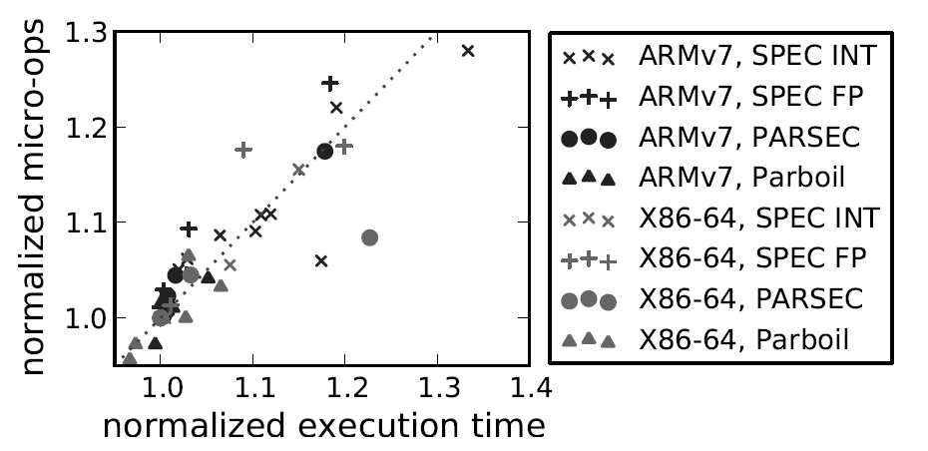
Compiler Overhead

Slide 97
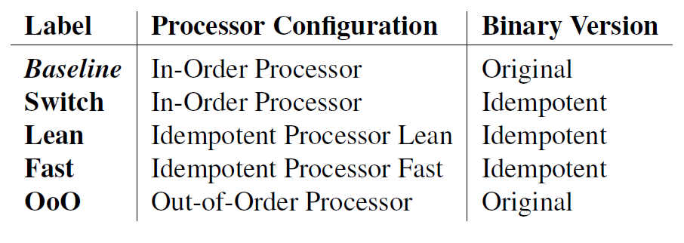
Performance Evaluation

Slide 98
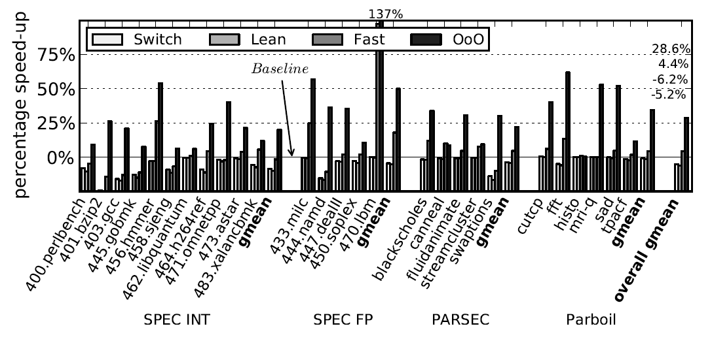
Performance Evaluation

Slide 99
Using Idempotence
Lightweight speculation support for GPUs
Efficient software only fault recovery
Hybrid Idempotent-OOO processors
OpenRISC FPGA-based prototype implementation

Slide 100
A Vertical Approach
Exposing Application Error-Tolerance to Hardware
Relaxed hardware reliability
Principle of Idempotence
Idempotent Processors
Sampling-DMR: a formally proven detection mechanism
Exposing Application Execution to Hardware
DySER Architecture

Slide 101
Sampling-DMR
Fault
occurs
Original Execution
errors
Time
Redundant
Execution
detection
Doing DMR 1% of time: we call it 1%-DMR.
It detects all permanent faults eventually.
Faults continue generating errors.
100% detection, no fault model assumption (like full-time DMR).
The energy overhead is low.

Slide 102
DySER Architecture
Fetch Decode Execute Memory WriteBack
Decode
Exec
Units
I$
Register
File
D$
DySER
Integrated into OpenSPARC

Slide 103
Conclusions
Technology limitations force radical designs
Exploit application trends
Idempotent Processing
Sampling-DMR
Specialization
End-to-end approaches can help continue Moore’s Law

Slide 104
An Example

Slide 105
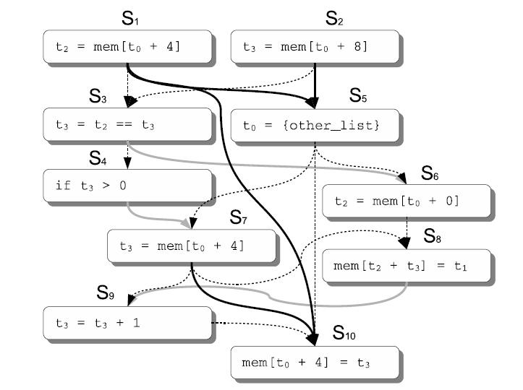
Program Dependence Graph

Slide 106
Remove artificial antidependences

Slide 107
New PDG

Slide 108
Idempotence Analysis
Formally equivalent to vertex-cut problem…
I will spare you all the details ☺

Slide 109
Results: The Potential

Slide 110
Results: Compiler-constructed

Slide 111
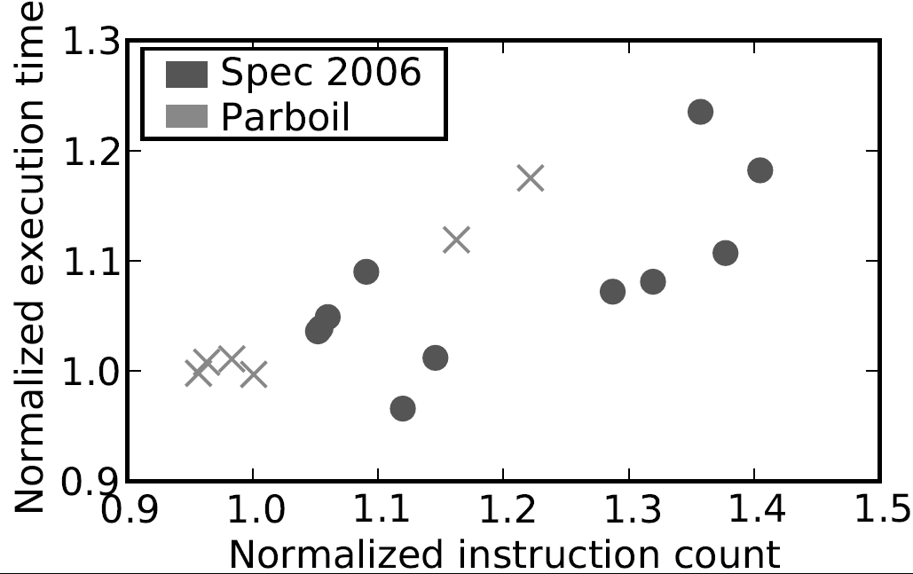
What is the overhead?

Slide 112
Hmm…these regions look interesting…
Can’t you do more with this?

Slide 113
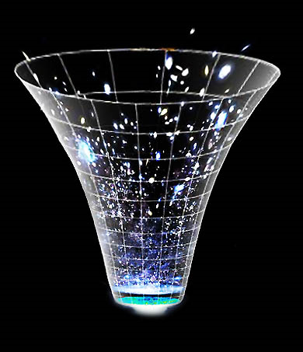
Yes, they are ideal candidates for specialization

Slide 114
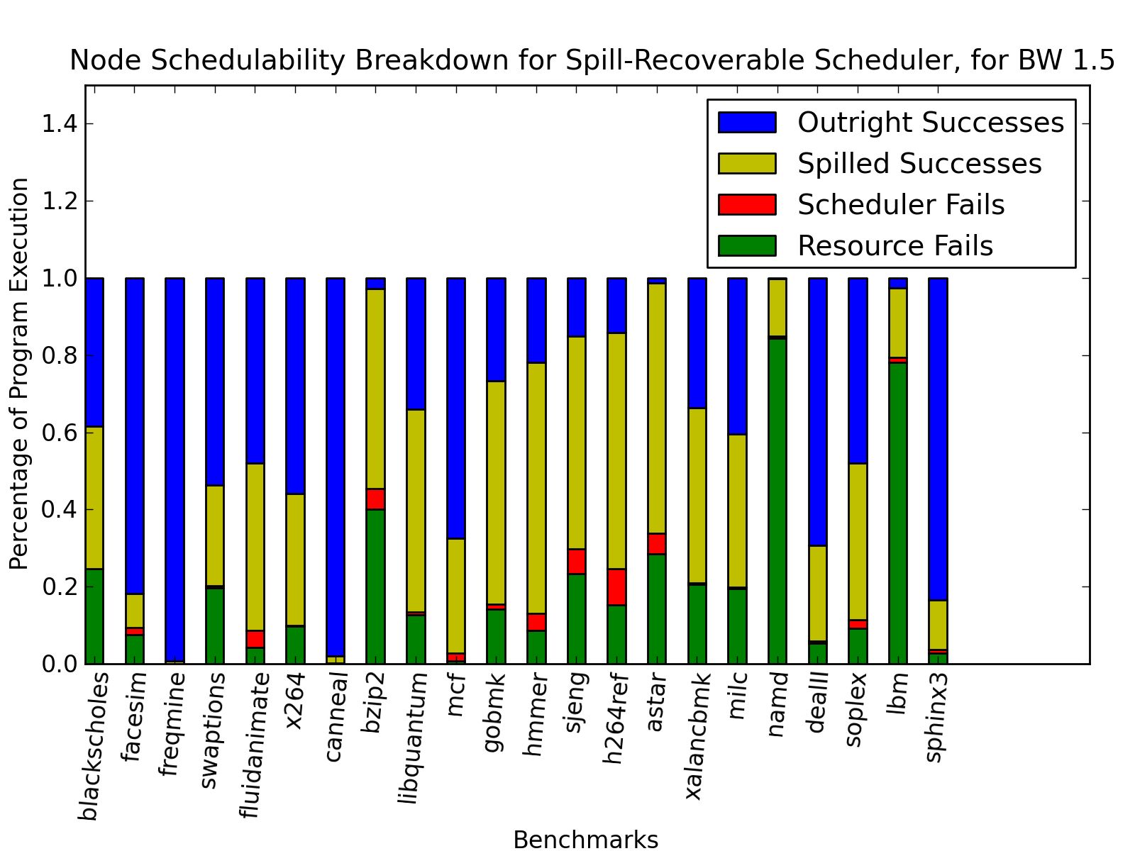
Scheduler Effectiveness

Slide 115
Future Work
Better software support
Binary instrumentation for Relax and DySER
Hardware support
What are the chip-level area and power savings?
Is Relax hardware truly simpler?
DySER+ OpenSPARC prototype under development
ARM, SPARC, x86 backends
Other domains
Software rollback for hardware transactional memory?
Notes:
Our results for Relax are promising, and Relax opens up many avenues for future research.
[click]
Our language-level annotations work well and require little source code modifications, but they do require source code modifications, and programming a whole application where everything is inside a relax block is time consuming.
Can we do better in software?
First,
is there a way we can do more work in the compiler. The compiler already correctly handles recovery over a region, can we also use the compiler to identify suitable regions?
Second,
If we can do it in a compiler from source code, maybe we can even do it at the level of binary code through a binary rewriting tool.
Finally,
There is also a language-level extension we could consider where relax blocks can be nested inside of each other.
[click]
For the hardware,
We would like to know, what are power and area savings in real terms?
Is Relax hardware truly simpler?
[click]
Relax is a framework for software recovery. I’ve talked about it here as a framework for managing hardware faults, but the same principles could really apply to anything in the hardware that needs recovery.
For instance, the principles behind Relax could do rollback for hardware transactional memory.
[click]
Finally, discard behavior is useful to some applications
But it is hard to reason about
And it depends on the discard occurring at a regular, more-or-less uniform rate, which is perhaps not realistic. Are there things we can do in the hardware that can make this expectation more reasonable? Are there things we can in software to help programmers reason about the non-determinism?
These are some of the areas we believe present interesting opportunities for future work.

Slide 116
Summary
Emerging Architectures avoid complexity
Emerging Applications
Error tolerant
Large regions with little or no side-effects
Relax : an architectural framework for software recovery
ISA: an interface to define it
Software: support for applications to use it
Hardware: hardware that enables it
DySER: Datapath specialization for energy
Notes:
To summarize this talk,
[click]
Many-core architectures are simple but hardware fault recovery can be complex
[click]
Emerging applications exhibit error tolerance, which allows alternative recovery behaviors, and have few side-effects, which allows rollback recovery to require little or no saving of state.
[click]
Software recovery is a natural fit
We propose Relax, an architectural framework for software recovery that leverages hardware detection
We have described the ZISA extension, software support for applications to use it, and hardware that enables it

Slide 117
?
http://www.cs.wisc.edu/~karu

Slide 118
Failure Types
Any node that depends on a “resource failure” is also considered a resource failure.
Any node that depends on a “scheduler error,” [but not a resource failure] is also a scheduler error.
Resource Failure
Scheduling Failure
In
In
In
×
×
+
<<
/
Out
Out
Out

Slide 119
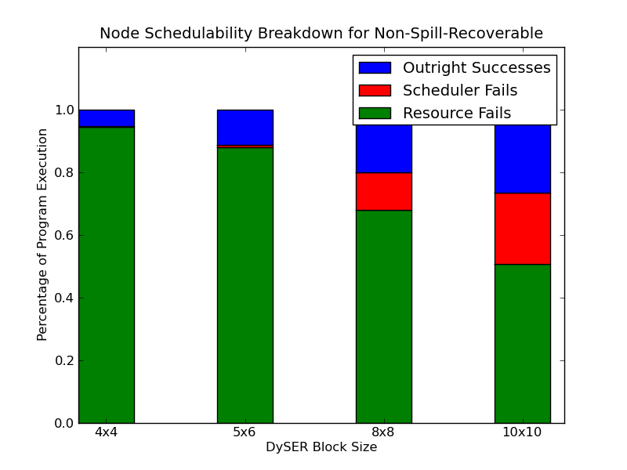
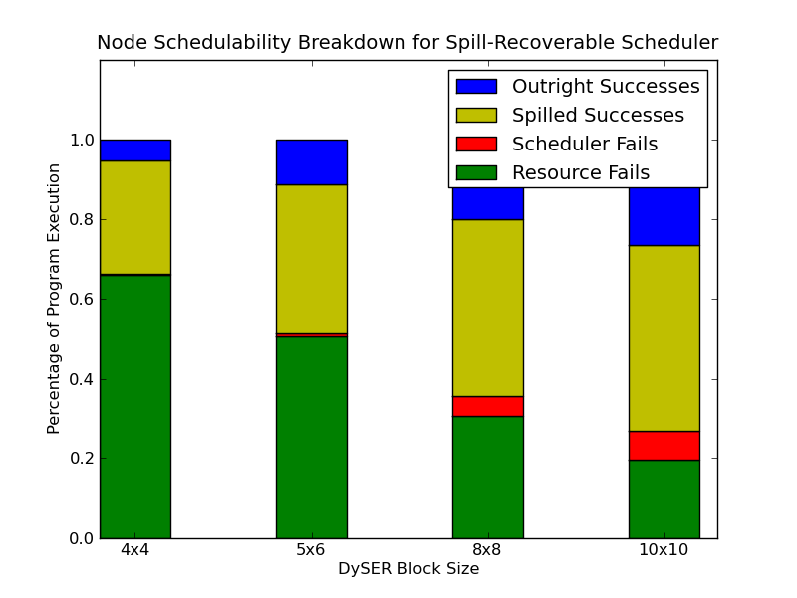
Shedulability vs Size
Schedulability looks abysmal, even with a large DySER block.
This presumes that computation slices with failures cannot be mapped at all.
Lets pretend we can spill some nodes back to the load slice:

Slide 120
Can Bandwidth Help?
We define “DySER bandwidth” to be the number of links between adjacent switches.
Fractional bandwidth is distributed randomly throughout the grid.

Slide 121
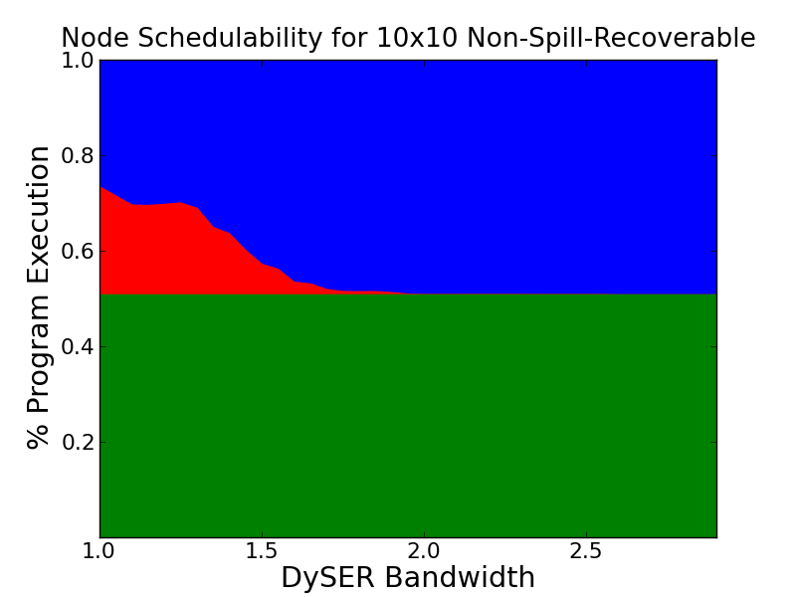
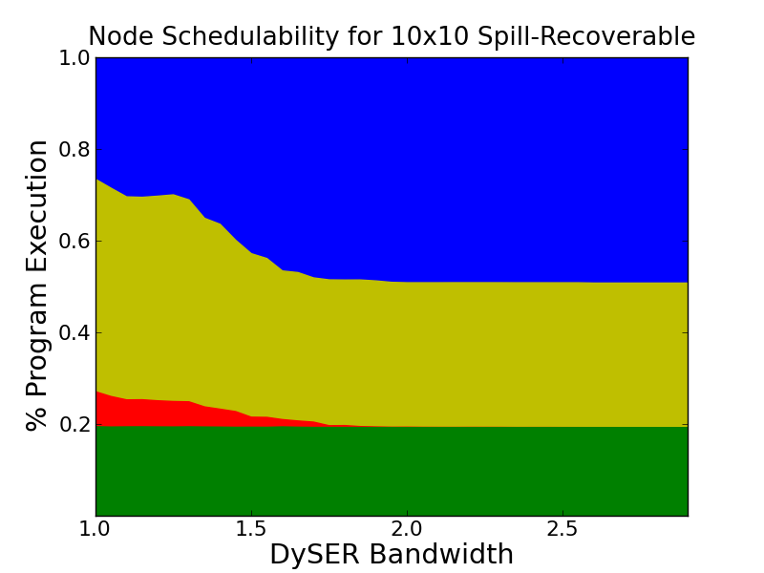
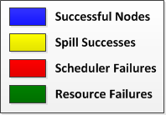
Bandwidth Results
All possible nodes are scheduled with BW 2.0
Scheduling spill nodes very important regardless of the bandwidth.

Slide 122
Benchmark Comparison

Slide 123
Resource Failure Composition
ALU dominates other Resources Errors.
This is because ALU’s have the PHI capability.
Shift resources from conversion/mult to ALU?
Do we need Divide units at all? (they are big)

Slide 124
Resource Failure Elimination
Possibilities:
Iteratively play with resource allocation.
This can only take us so far.
Allow all nodes to have PHI capabilities.
This leads to harder scheduling decisions for a greedy placement.
Let spilled computations route through DySER.
Complicated and breaks acyclic property.
Re-schedule spilled nodes.
If we have the ability to allow spill nodes in the first place, this may be the easiest solution.

Slide 125
ISA Semantics
Errors must be “spatially contained” to the target resources of a relax block
Misdirected stores and register not recoverable by Relax!
Errors must be “temporally contained” to the scope of a relax block
ECC (or other technique) necessary for memory
Cache coherence, cache writeback, etc. require other mechanisms
Control flow must be “legal” (follow static control flow edges)
Includes hardware exceptions (must wait on detection before trap)
Atomic operations (e.g. atomic increment) are problematic
Not supported (sorry)

Slide 126
Fault Detection
Short latencies important for
Detecting misdirected stores
Detecting misdirected register writes
Otherwise, latencies depend on region sizes
50 cycle regions + 5 cycle latency = 10% overhead
Average region sizes in paper = 1000 cycles
Then, 10 cycle latency = 1% overhead

Slide 127
“Optimal” Error Rate
optimum
Hardware Efficiency
Execution Time
Overall Efficiency
EDP
Time
EDP
Error rate
Error rate
Error rate

Slide 128
Multicore Solutions
Asymmetric Topologies
3.5x

Slide 129
Multicore Solutions
Dynamic Topologies
3.5x
[Chakraborty (2008), Suleman et al (2009)]

Slide 130
Multicore Solutions
Composed/Fused Topologies
3.7x
[Ipek et al (2007), Kim et al (2007)]

Slide 131
Multicore Solutions
GPU-Style Cores
2.7x

Slide 132
Hardware Organization
Homogenous Relax
All cores with no hardware recovery support
Statically Heterogeneous Relax
Some cores with; some cores without
Dynamically Heterogeneous Relax
Hardware recovery adaptively disabled
FLEXIBLE Design
Normal cores
Hardware recovery
“Relaxed” cores
No hardware recovery
Notes:
The other piece we consider are the hardware organizations that can take advantage of the capabilities of Relax for improved efficiency.
[click]
Hardware with all identical cores that depend solely on software recovery is one option, but not the only option.
[click]
[click]
Another alternative is a statically heterogeneous organization, where some cores are built with hardware recovery support and others are not.
This alternative might be good for hardware that is already heterogeneous, or hardware that supports fine-grained parallelism, where
Relax blocks can be rapidly offloaded onto neighboring cores that have no hardware recovery support.
[click]
[click]
Finally, a third alternative is a dynamically heterogeneous organization, where hardware recovery support is adaptively disabled.
[click]
The hardware is designed with hardware recovery support,
[click]
But it is adaptively disabled for relax blocks, to conserve energy.
Overall, we see that there are many options and Relax enables flexibility in hardware design.

Slide 133
Hardware
Evaluation
ISA
Software
Notes:
That completes our overview of Relax,
[click]
Now we’ll move into our evaluation

Slide 134
Methodology
Instruction-level fault injection
Execution time model
Statically Heterogeneous
Architecture
Energy model
Energy-delay product (EDP)
Analytical model for hardware efficiency
Notes:
To evaluate Relax under timing speculation
[click]
We use instruction-level fault injection
[click]
And we measure simulated execution time modeling a statically heterogeneous hardware organization
[click]
We assume a 5 cycle cost to enqueue a relax block on a neighboring core
[click]
and a 5 cycle cost to flush the pipeline and jump to the recovery destination.
[click]
To measure energy efficiency, we use the energy-delay product (abbreviated EDP) as our metric
And we use an analytical model to estimate hardware energy efficiency under timing speculation as a function of the error rate.
The model produces this graph.
[click]
As the error rate is allowed to increase, the efficiency of the hardware improves because circuit-level timing margins can be relaxed.
We combine this with our empirically measured execution time data which looks like this.
[click]
Here, as the error rate increases, execution time increases exponentially as recovery becomes more and more frequent.
[click]
When we combine these two graphs, we get the overall efficiency of the system. The equation we use is the following, which follows from the definition of energy-delay.
[click]
The hardware efficiency and execution time curves combined yield an optimum efficiency point
[click]
where the overheads of recovery are balanced against the efficiency improvements in the hardware.
In our results, which we present on the following slides, the data shown are the data obtained at this global optimum.

